Slide 1

Anime Analysis: Trends and Insights
Examining popular genres, studios, and factors influencing anime ratings.

Slide 2


Genre Distribution
1
Top Genres
Fantasy, Action, Comedy most common.
2
Viewer Preference
Mystery, Thriller, Sci-Fi receive higher ratings.
3
Popularity
Action and Adventure have high member counts.

Slide 3
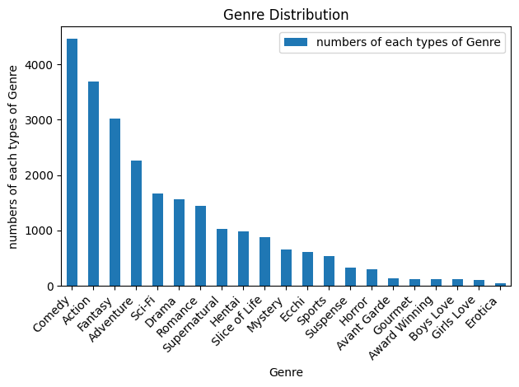
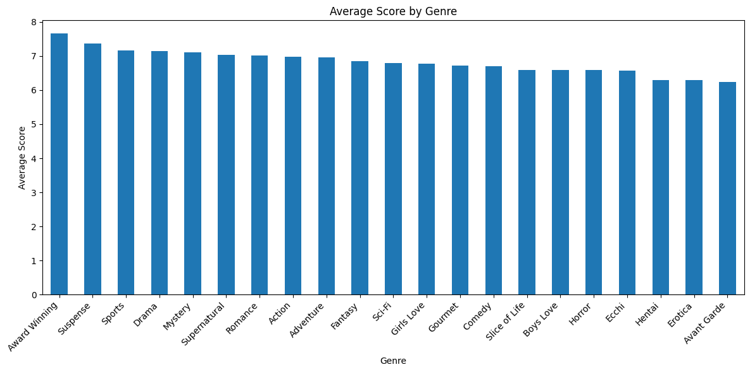
We can see that Fantasy, Action, Comedy, Adventure, Drama had the most numbers of genres, it means that most viewer liked to watch fight scence. These charts show which genres are most common and which tend to have higher scores. the second plot function display the average score for each genre. this helps identify which genres tend to receive higher ratings from viewers. Genres like Mystery. Thiller and Sci-Fi tend to have higher average scores compared to others, indicating a preference for these genres among viewers who rate anime

Slide 4
Popularity vs Score Analysis
Correlation
Slight upward trend between popularity and score.
Variation
Popular anime with low scores exist.
Factors
Genre, story, animation quality influence scores.

Slide 5
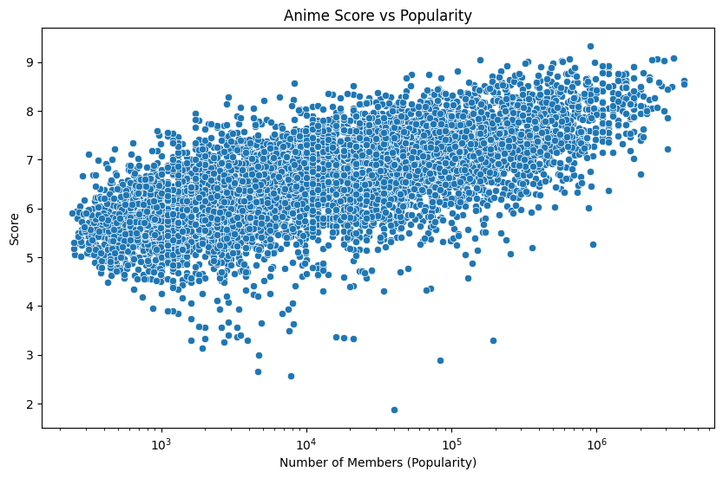
The scatter plot generated in the function shows the relationship between an anime's popularity (measured by the number of members) and its score. The x-axis represents the number of members (popularity), and the y-axis represents the score. Each point on the plot represents an anime. There's a slight upward trend in the scatter plot, suggesting that more popular anime tend to have higher scores. This means that anime with more members generally receive better ratings.
However, the trend is not very strong, and there's a lot of variation in the data. This means that there are many popular anime with low scores and many less popular anime with high scores. The popularity and score analysis suggests that there's a tendency for more popular anime to have higher scores, but this relationship is not very strong.
Correlation between popularity and score: 0.41

Slide 6


Release Date Trends
1
Yearly Trends
Fluctuations in number of releases over years.
2
Seasonal Patterns
Certain months have more releases.
3
Industry Insights
Aligned with broadcasting seasons and events.

Slide 7
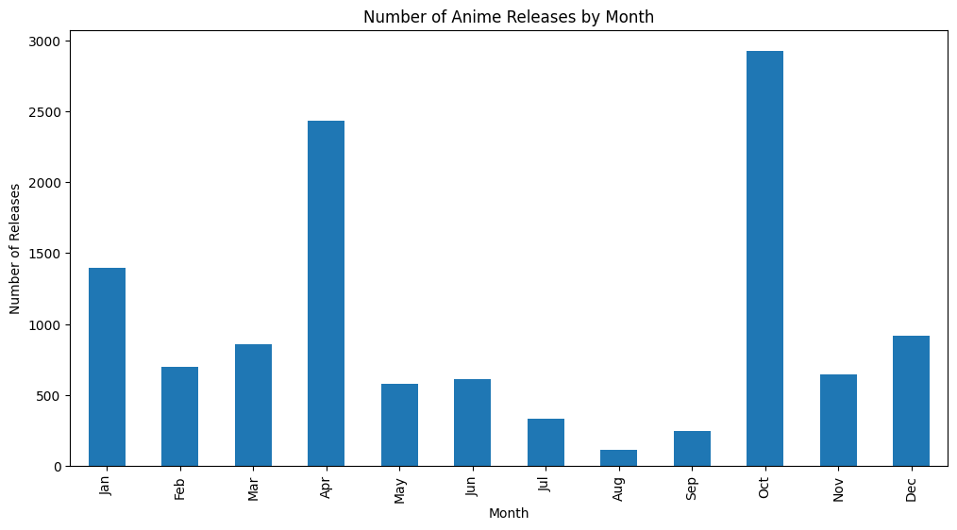
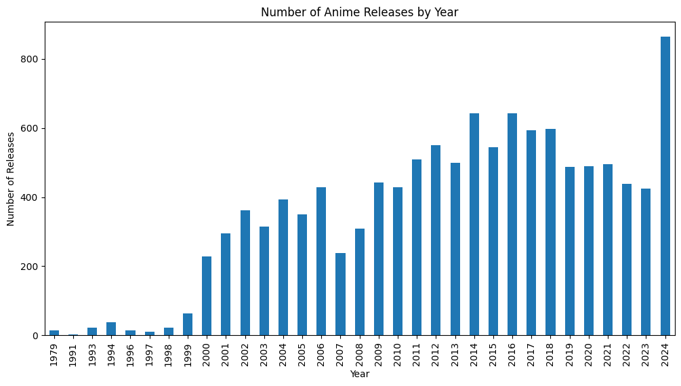

Slide 8
Studio Analysis
Prolific Studios
High-Quality Studios
Balance
AQUA ARIS, MAPPA, OLM among top producers.
Nut, Bones, TROYCA have highest average scores.
Some studios balance quantity and quality.

Slide 9
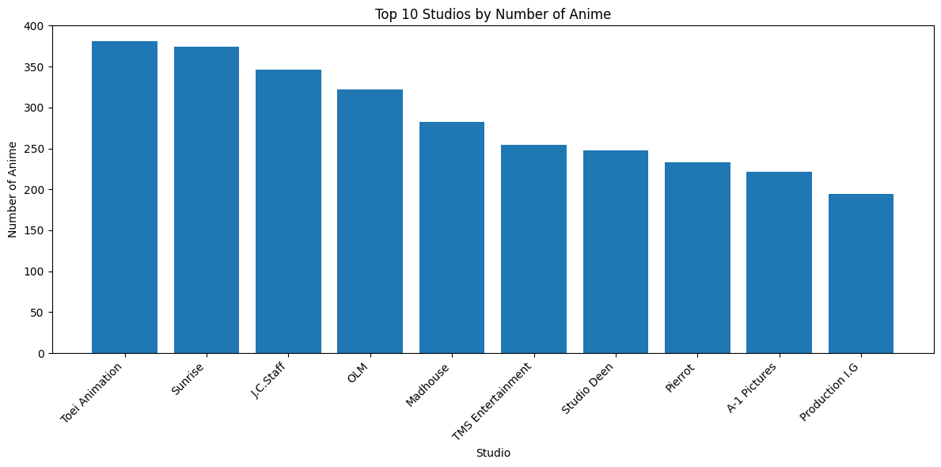
Top 10 Studios by Number of Anime:
Toei Animation: 381
Sunrise: 374
J.C.Staff: 346
OLM: 322
Madhouse: 282
TMS Entertainment: 254
Studio Deen: 248
Pierrot: 233
A-1 Pictures: 222
Production I.G: 194

Slide 10
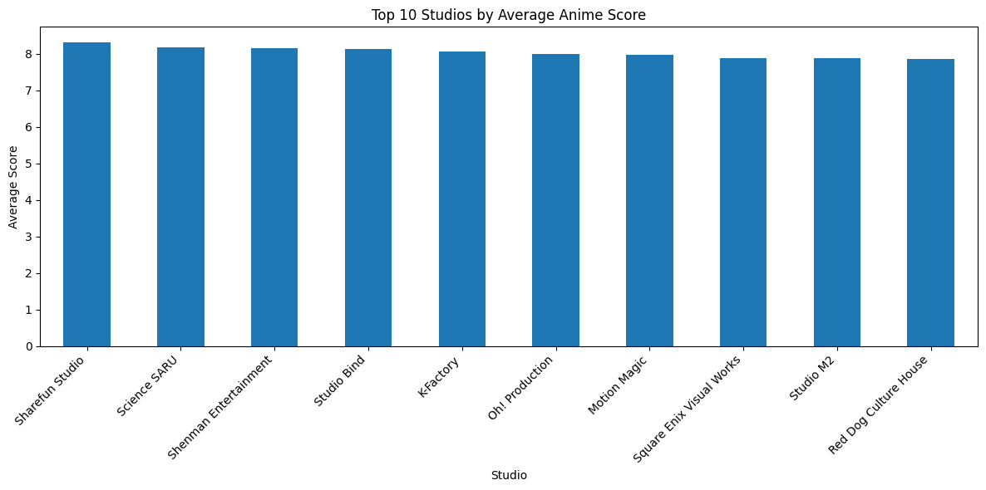
Top 10 Studios by Average Score:
Sharefun Studio: 8.32
Science SARU: 8.18
Shenman Entertainment: 8.16
Studio Bind: 8.12
K-Factory: 8.06
Oh! Production: 8.00
Motion Magic: 7.96
Square Enix Visual Works: 7.89
Studio M2: 7.88
Red Dog Culture House: 7.85

Slide 11
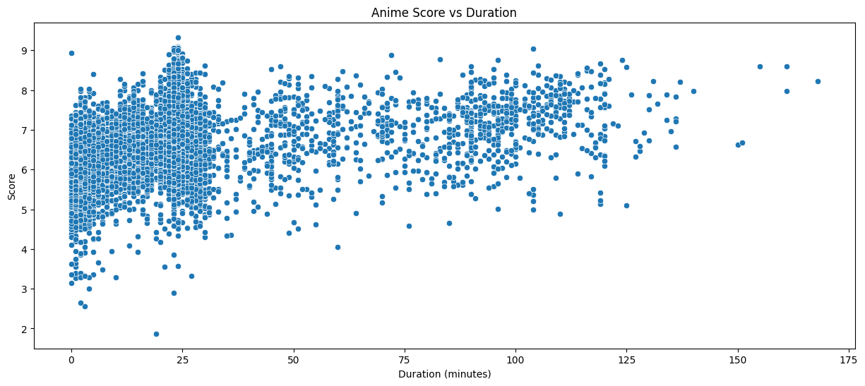
The scatter plot generated in the function shows the relationship between an anime's popularity (measured by the duration) and its score. The x-axis represents the duration (minutes, and the y-axis represents the score. Each point on the plot represents an anime. There's a slight upward trend in the scatter plot, suggesting that longer duration anime tend to have higher scores. This means that anime with longer duration generally receive better ratings. However, the trend is not very strong, and there's a lot of variation in the data. This means that there are many longer duration anime with low scores and many shorter duration anime with high scores.

Slide 12


Genre Popularity
Hypothesis
Action and Adventure genres tend to have higher member
Counts compared to other genres.
Top Genres
Suspense, Girls Love, Sports most popular.
Statistical Analysis
No significant difference between Action/Adventure and others.
Implications
Diverse genre appeal in anime community.

Slide 13
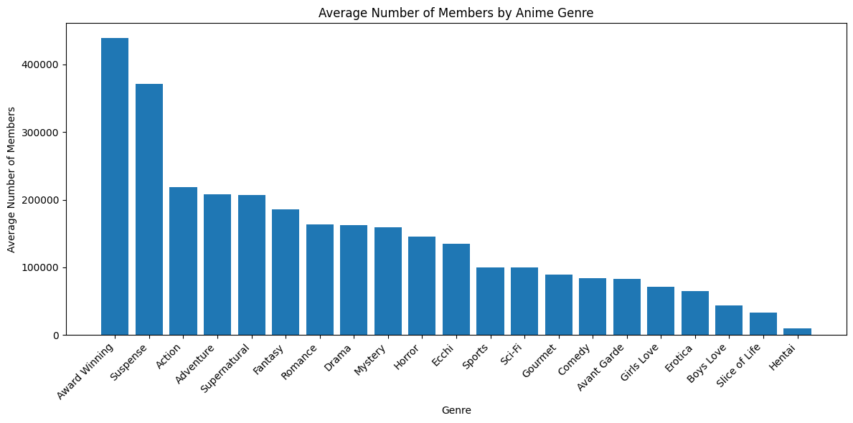
Top 5 Genres by Average Member Count:
Award Winning: 439127
Suspense: 371087
Action: 218454
Adventure: 208393
Supernatural: 206505
Statistical Analysis:
Action vs Other Genres - T-statistic: 13.7427, P-value: 0.0000
Adventure vs Other Genres - T-statistic: 10.0516, P-value: 0.0000

Slide 14
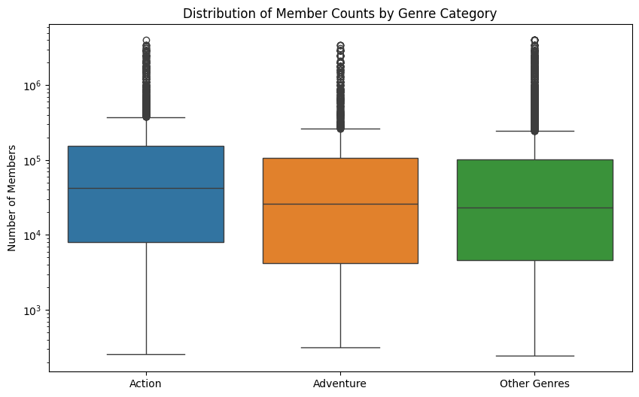
The bar plot generated by analyze_genre_popularity shows the average number of members for each anime genre. It visually compares the popularity of different genres. Action and Adventure genres are highlighted in red on the bar plot. This allows for easy comparison with other genres to assess if we indeed have higher member counts. The function prints the top 5 genres by average member count. This provides a quick overview of the most popular genres based on my data. T-tests are performed to compare the member counts of Action and Adventure genres against other genres. The results (t-statistic and p-value) help determine if there's a statistically significant difference in popularity. A box plot is generated to visualize the distribution of member counts for Action, Adventure, and other genres. It shows the median, quartiles, and potential outliers, providing a deeper understanding of the data spread. Since the p-value is less than 0.05, we reject the null hypothesis. This means there is enough evidence to conclude that there is a statistically significant difference in member counts between Action and Other Genres. Again, since the p-value is much less than 0.05, we reject the null hypothesis. This means there is enough evidence to suggest a statistically significant difference in member counts between Adventure and Other Genres.

Slide 15





Episode Count vs Score
Short Series
Medium Series
Long Series
1-12 episodes, average score 6.58.
13-26 episodes, highest average score 7.06.
27+ episodes, average score 6.88.
Research question: Is there a relationship between an anime’s score and the number of episodes it has?
Hypothesis: Anime series with a moderate number of episodes (13-26) tend to have higher scores than very short or very long series.

Slide 16
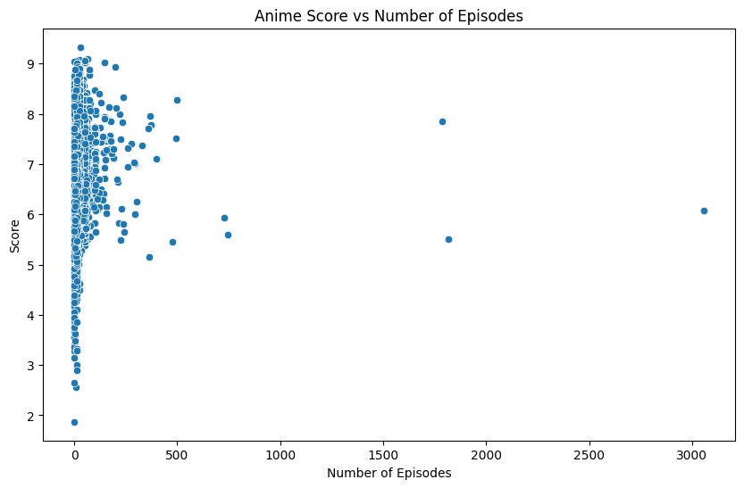
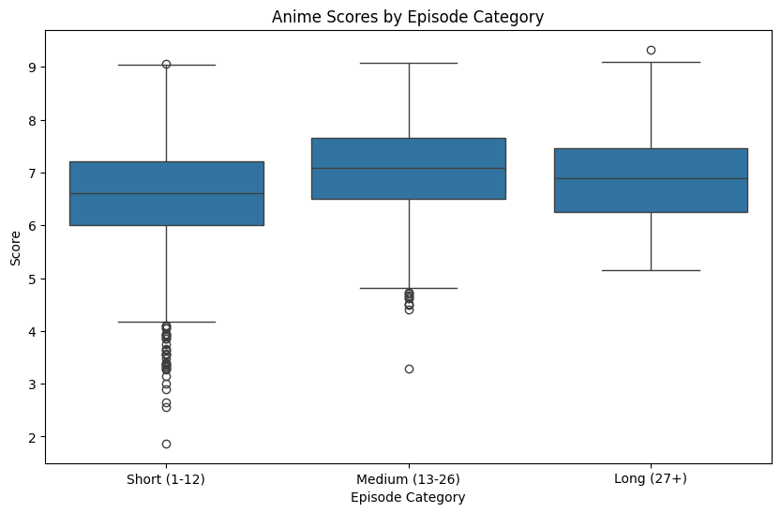
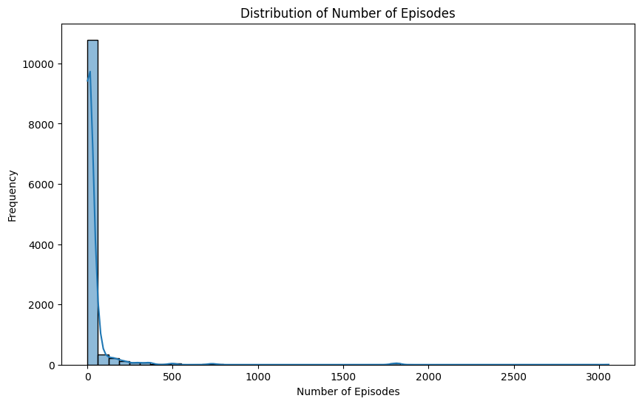
Average Scores by Episode Category:
episode_category
Medium (13-26) 7.068920
Long (27+) 6.888177
Short (1-12) 6.584129
Name: score, dtype: float64
ANOVA results: F-statistic = 339.94, p-value = 0.0000
Correlation between episodes and score: r = 0.01, p-value = 0.2980

Slide 17
The scatter plot visualizing the relationship between the number of episodes and the score didn't reveal a clear upward or downward trend. This observation is supported by the correlation analysis, which indicated a weak positive correlation (r = 0.01) between episodes and score. However, this correlation was not statistically significant (p-value = 0.2980), suggesting that the number of episodes has a minimal linear impact on the anime's score.
Examining the box plot and average scores for different episode categories, we observed that anime with a moderate number of episodes (13-26) showed slightly higher scores compared to short (1-12) or long (27+) series. The average scores for these categories were 6.584129 for short, 7.068920 for medium, and 6.888177 for long series.
The ANOVA test, which compares the scores across different episode categories, yielded an F-statistic of 339.94 and a p-value of 0.0000. Since the p-value is lower than the typical significance level of 0.05, we reject the null hypothesis. This implies that there is statistical evidence to conclude that the number of episodes significantly affects an anime's score.
The histogram illustrating the distribution of episodes showed that most anime in the dataset have a moderate number of episodes, with a peak around 12-13 episodes. However, there's also a considerable number of anime with longer episode counts, extending beyond 50 episodes. This distribution suggests that while moderate-length series are common, there's a diversity in episode lengths among anime. Based on the combined results of the analysis, we do not find strong evidence to support the hypothesis that anime series with a moderate number of episodes (13-26) tend to have higher scores than very short or very long series. While there's a weak positive correlation between episodes and score, it's not statistically significant. The box plot, average scores, and ANOVA results further indicate that the number of episodes doesn't have a substantial impact on an anime's score. While moderate-length series are prevalent, the diversity in episode lengths across anime suggests that other factors, such as story, animation quality, and characters, might play a more significant role in determining an anime's score.
Limitations: It's essential to acknowledge the limitations of the analysis, such as the specific dataset used, which focuses on a particular season and year of anime releases. The sample size might not be fully representative of the entire anime landscape. Future research could explore a larger and more diverse dataset to confirm these findings and investigate other potential factors influencing anime scores.

